Slide 1
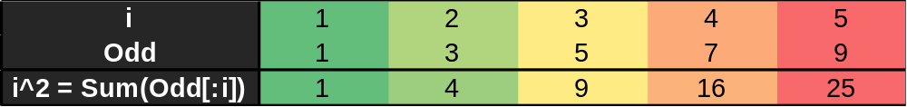
N^2 is sum of the first N ***** numbers

